Slide 1
Arduino basics
Arduino provides powerful libraries and examples to quickly make a project

Slide 2
Arduino examples
There are Arduino examples to be found for many projects such as
SWR bridge
https://duino4projects.com/arduino-rf-power-swr-meter/
CW Keyer
https://blog.radioartisan.com/arduino-cw-keyer/
Rotor Controller (with serial interface)
https://blog.radioartisan.com/arduino_rotator_controller/

Slide 3
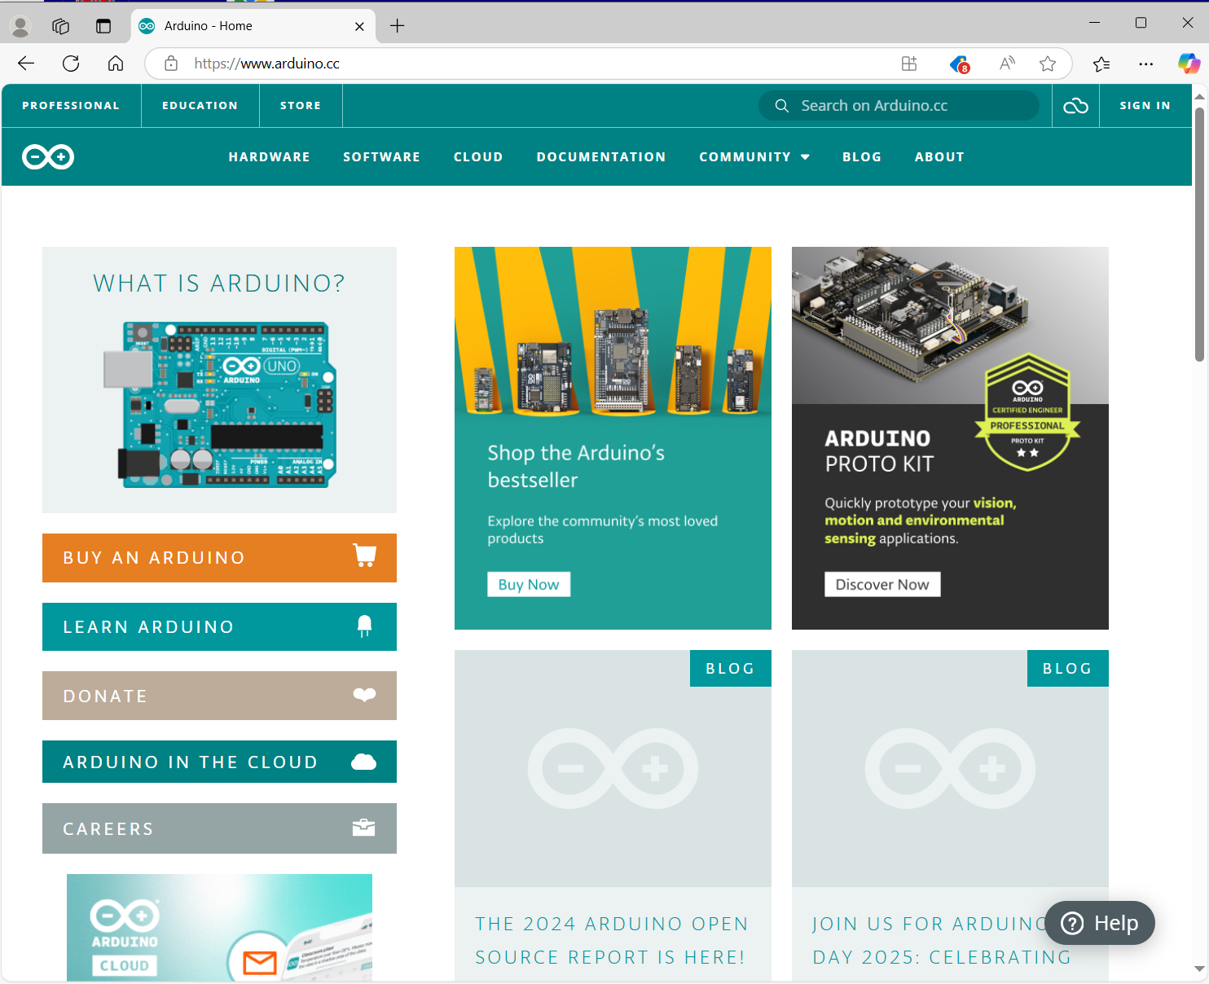
Start here at arduino.cc where the integrated develoment environment (IDE) can be downloaded.
Click the “software tab”

Slide 4
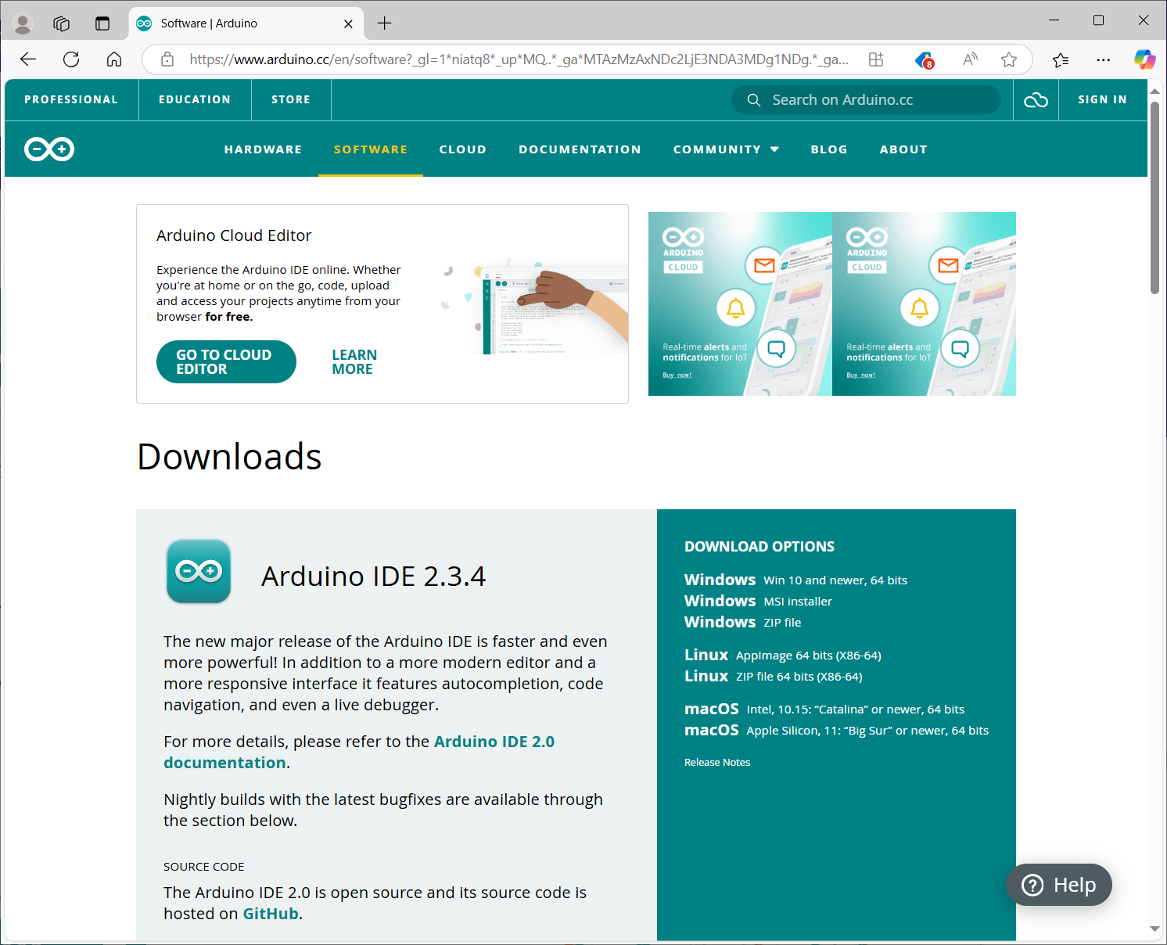
Choose the IDE version for your computer. I suggest the first option if you are a windows user.

Slide 5
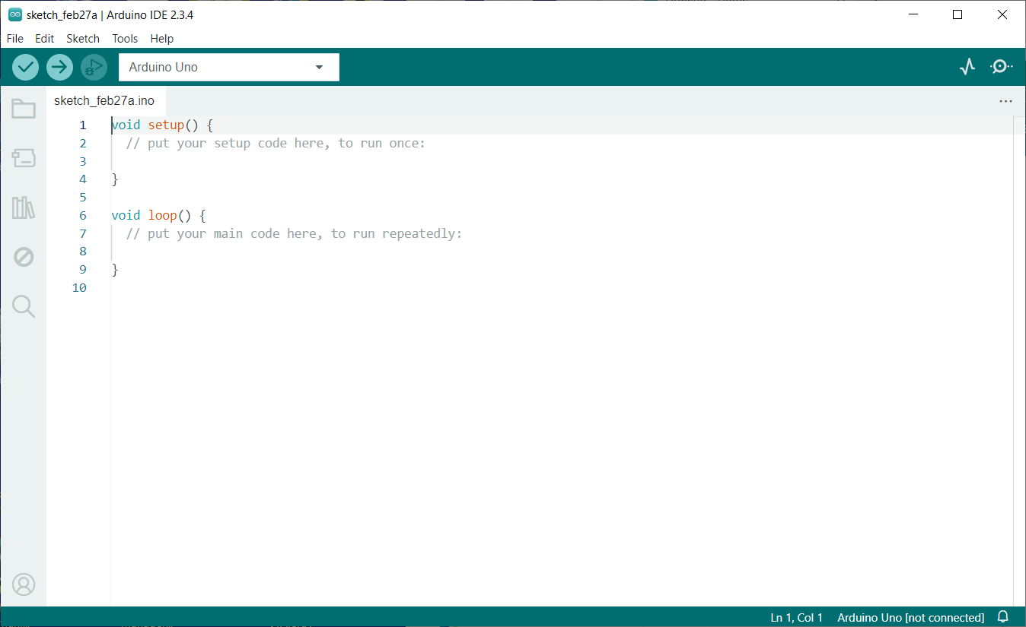
After download and install, run the Arduino IDE.
This should have a window like this with a basic “sketch” (this is what arduino calls a program)
Note the “books” icon left of the code window.

Slide 6
Libraries
The “books” icon on the left toolbar opens the library manager.
Each library will include example sketch
Using an example as a project base helps to get started
Combining examples from libraries synthesizes a project
Once basics are in place, algorithms can be added and optimized

Slide 7
Let’s do an example of a sketch that will read a temperature and humidity sensor and provide serial output of that data to the Arduino serial port, then an I2C LCD showing the data will be added.

Slide 8
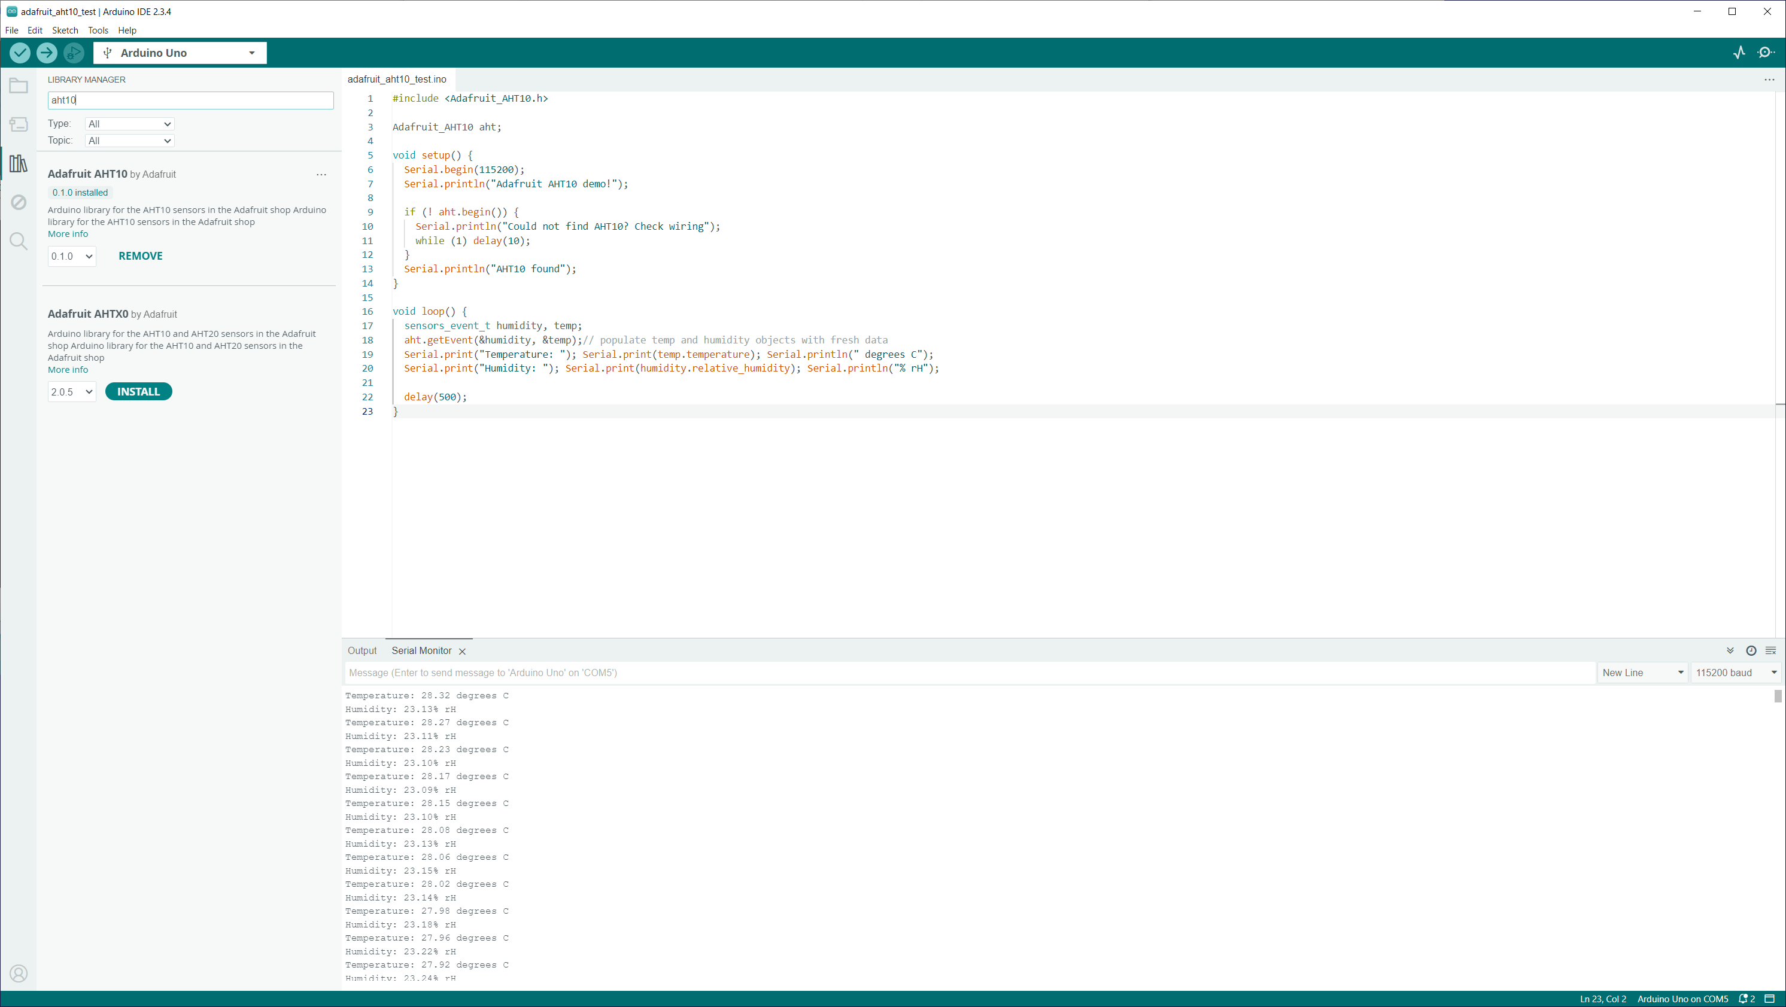
Start with the FILE menu and select New Sketch.
Then click the “books” or select menu TOOLS Manage Libraries
We are using an AHT10, and I2C LCD
So search for AHT10 and install the Adafruit AHT10 library

Slide 9
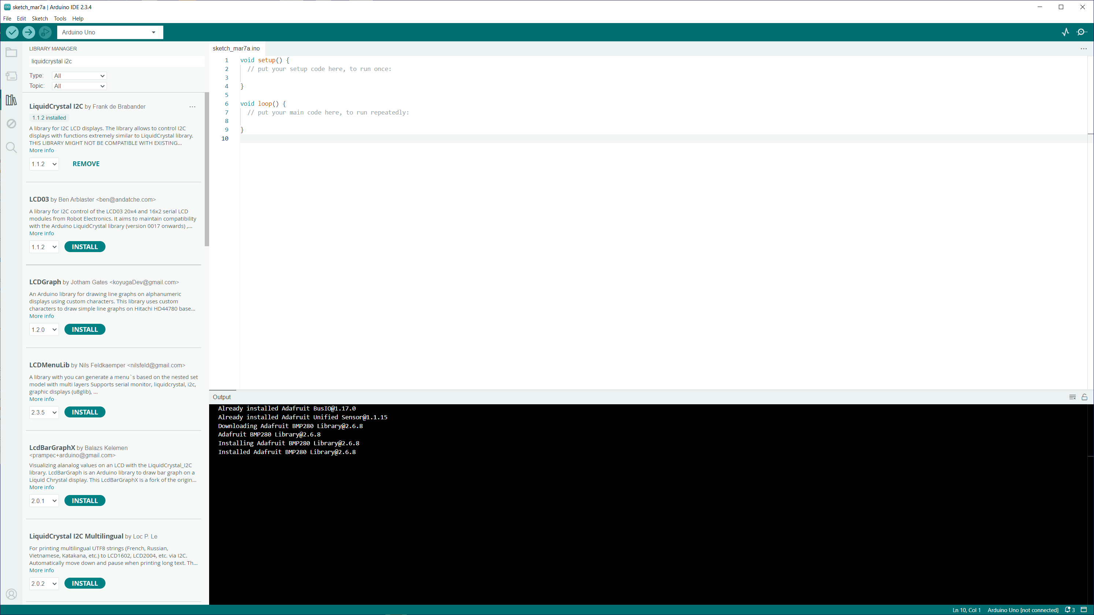
Then finally search for LiquidCrystal I2C and install

Slide 10
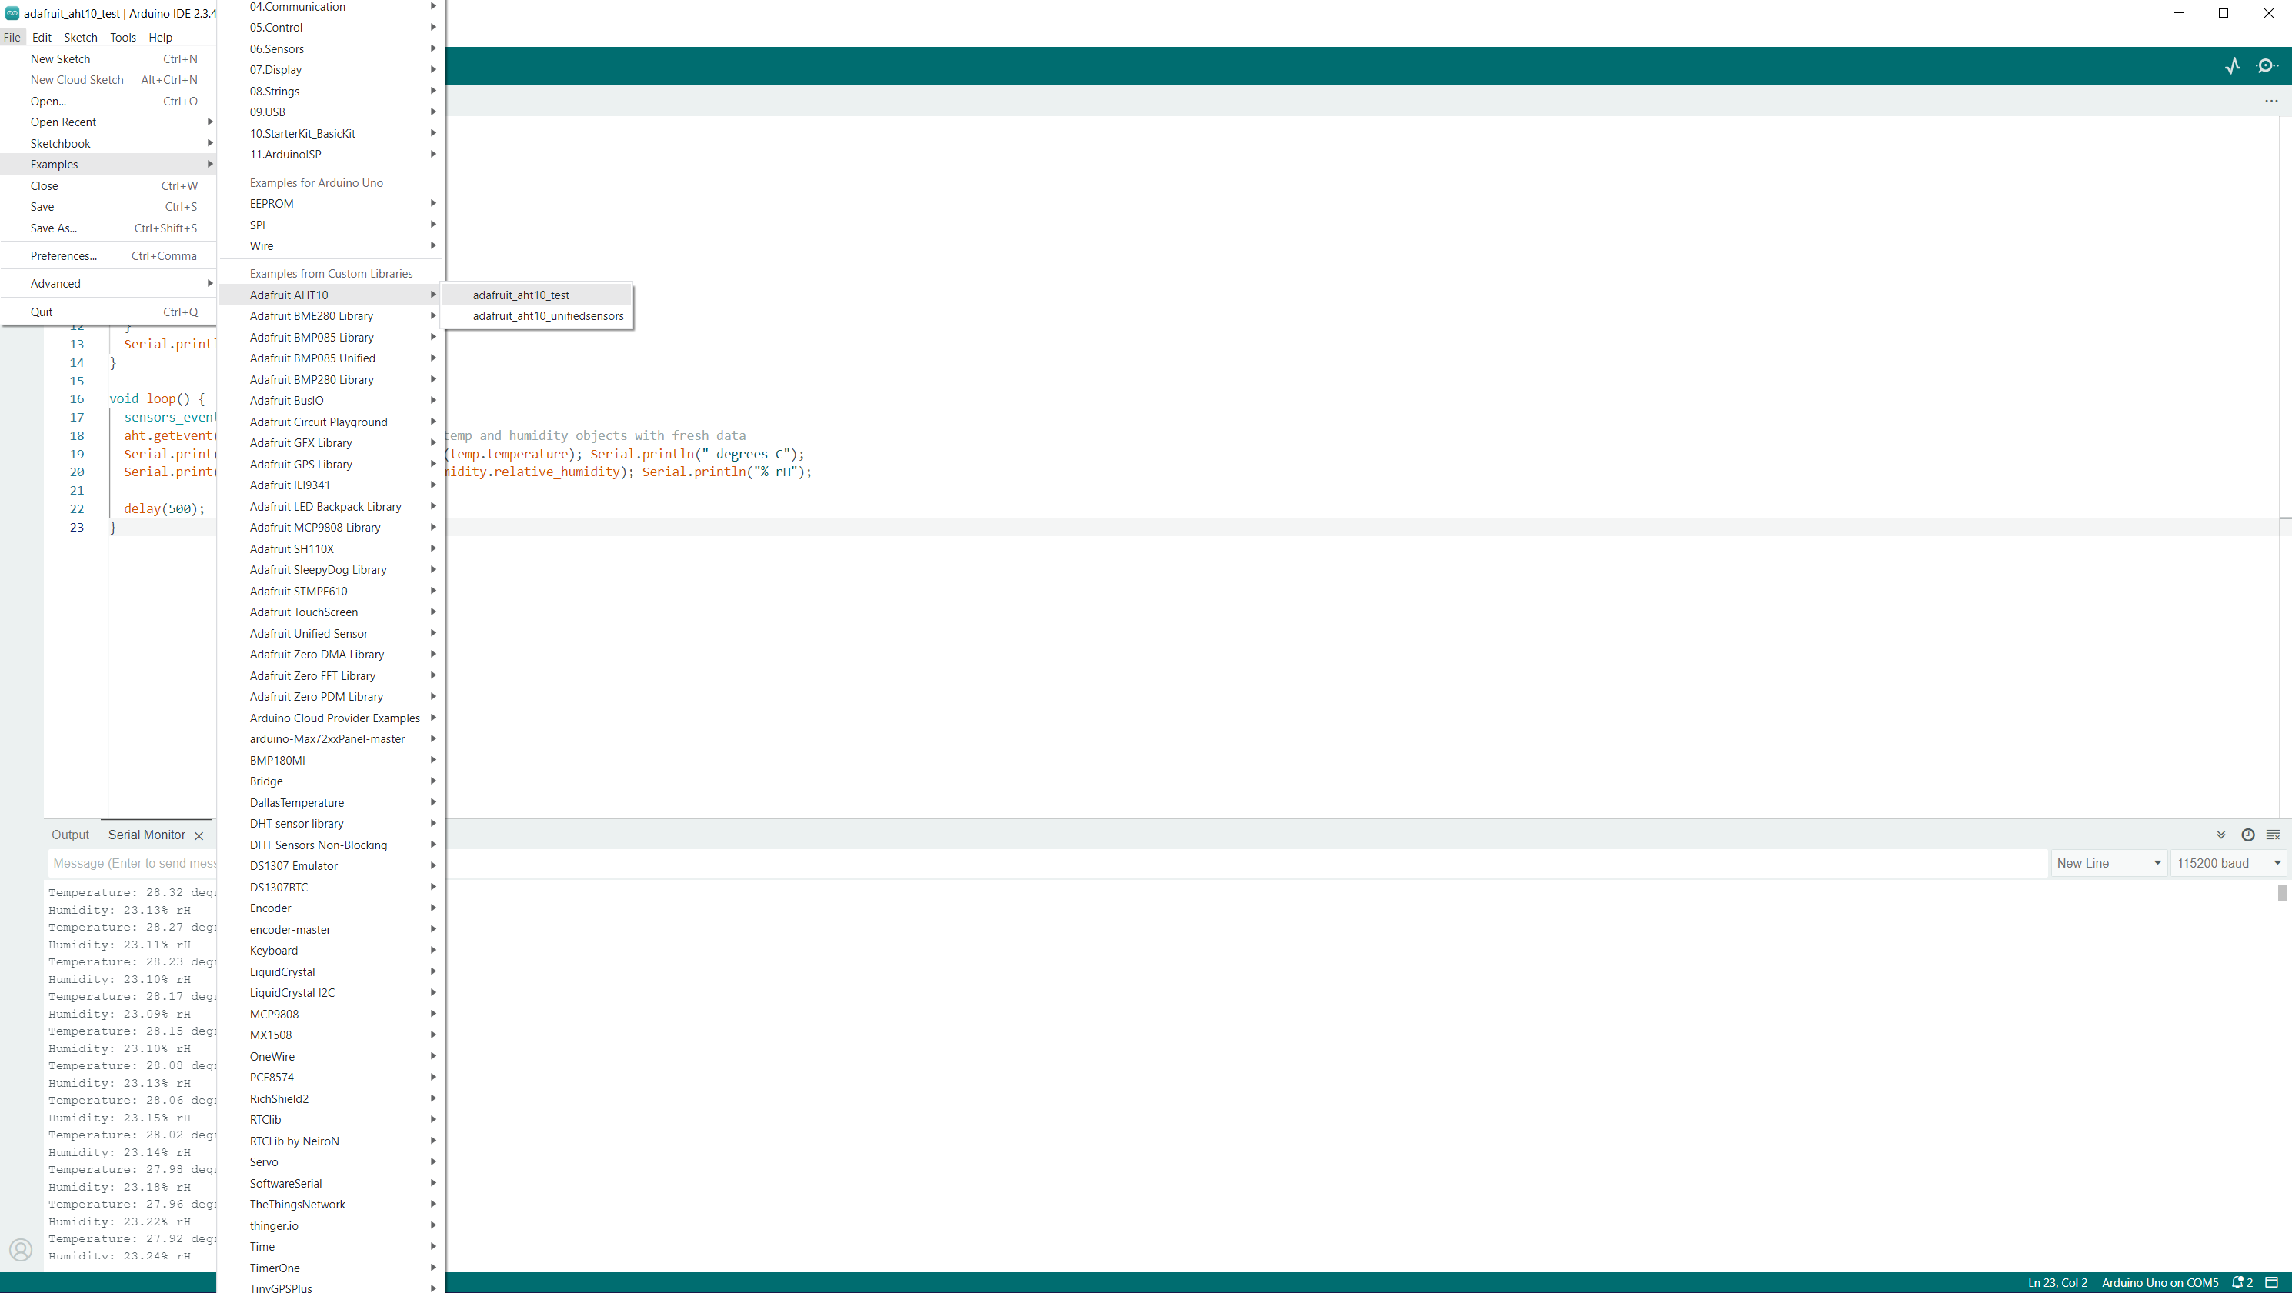
Now, let’s start.
Select menu File -> Examples ->
AdaFruit AHT10 →
adafruit_aht10_test
This will open a new sketch window

Slide 11
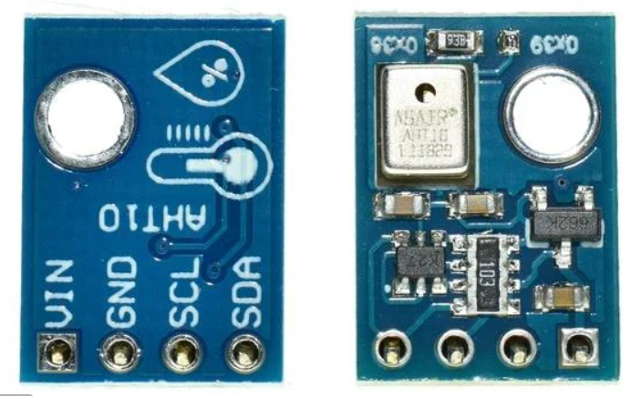
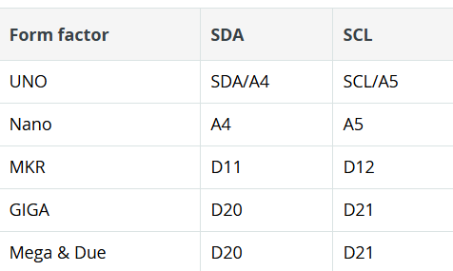
We need to wire the module to
5V vcc, GND, SDA (A4) and SCL (A5)
Wire the I2C and power pins to the Arduino.
The I2C pins can change based on the Arduino in use.
https://docs.arduino.cc/learn/communication/wire/
So be sure to use the correct SDA and SCL pins

Slide 12
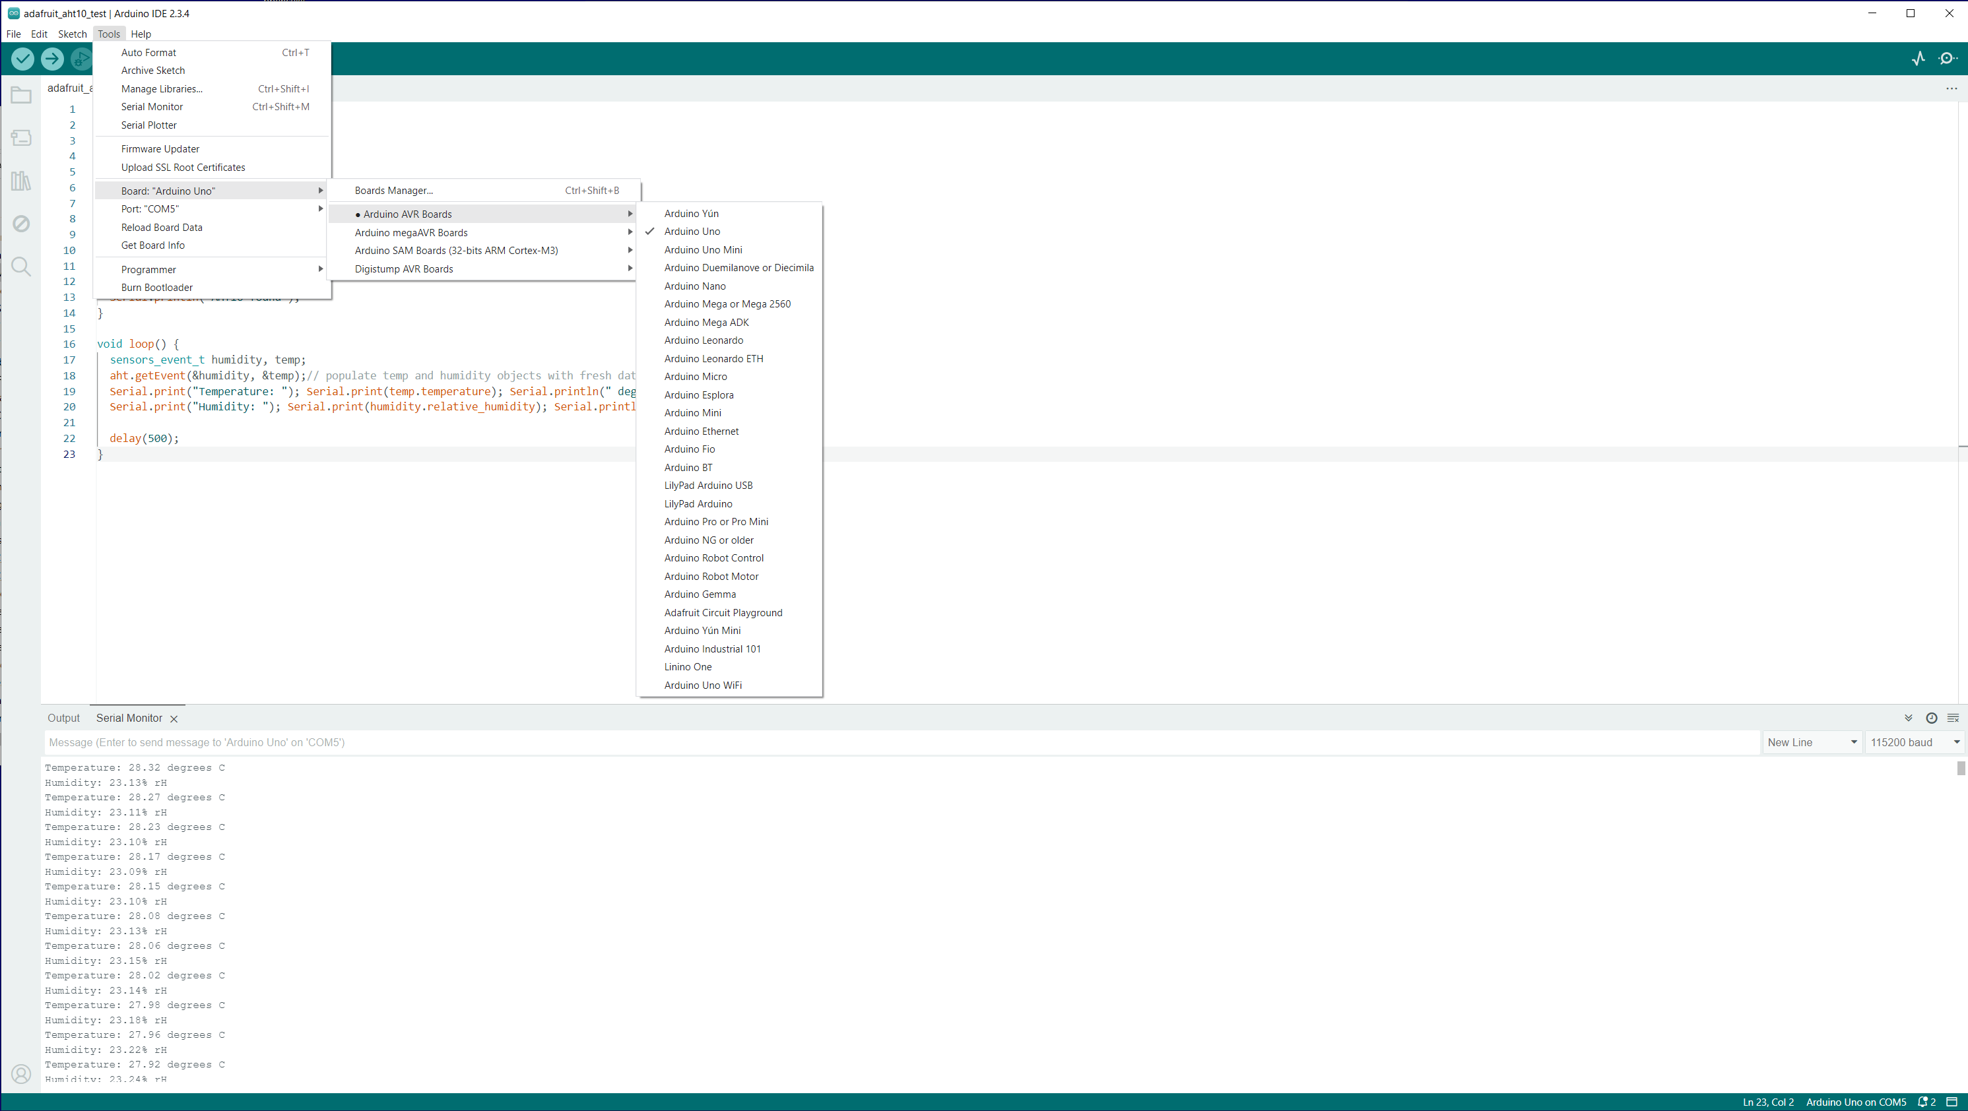
Once the module is wired, select the Arduino board and serial port from the Tools menu.
Next, Tools ->
Serial Monitor
And set the speed to 115200 (near lower right of the IDE window)
Lastly, select select menu Sketch ->
Upload
Or click the arrow near the top of the IDE window.
Temperature and Humidity data should begin showing in the serial monitor pane.

Slide 13
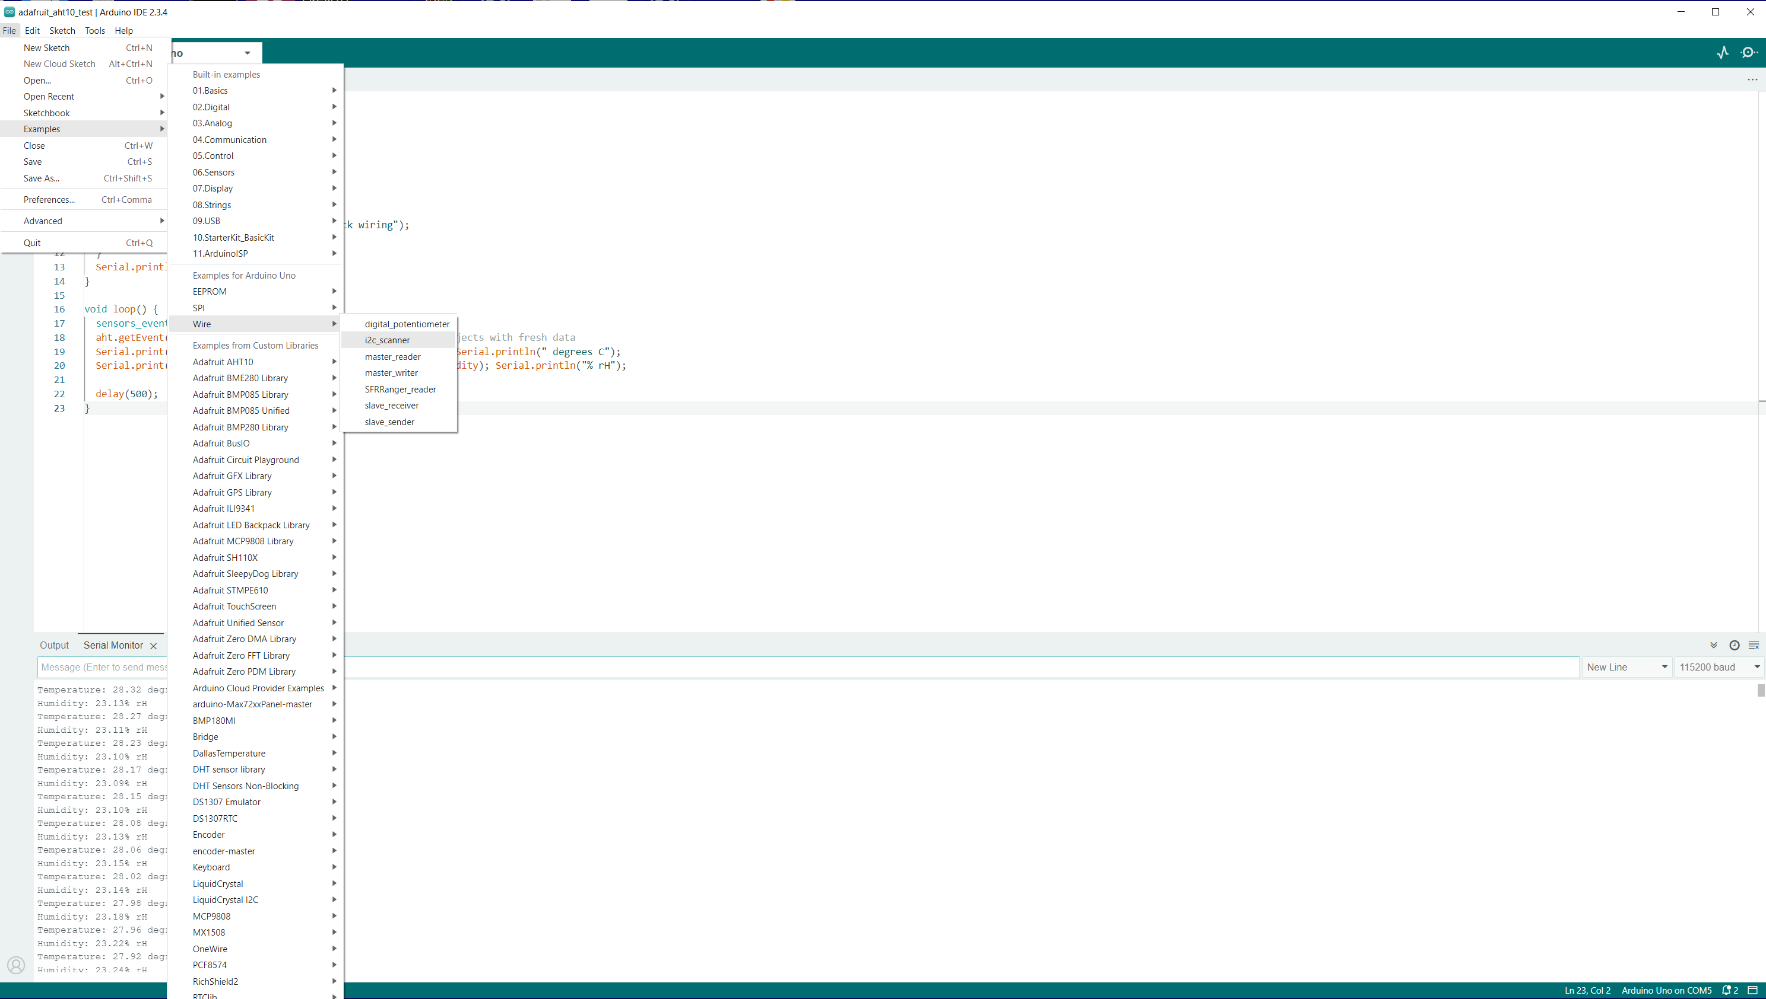
Next, we will add the I2C LCD.
This will require finding the address of the LCD display (they vary…)
Select menu File→ Example →
Wire →
I2C scanner
Change the Serial Monitor speed to 9600.
Take note of the address found (mine was 0x27)

Slide 14
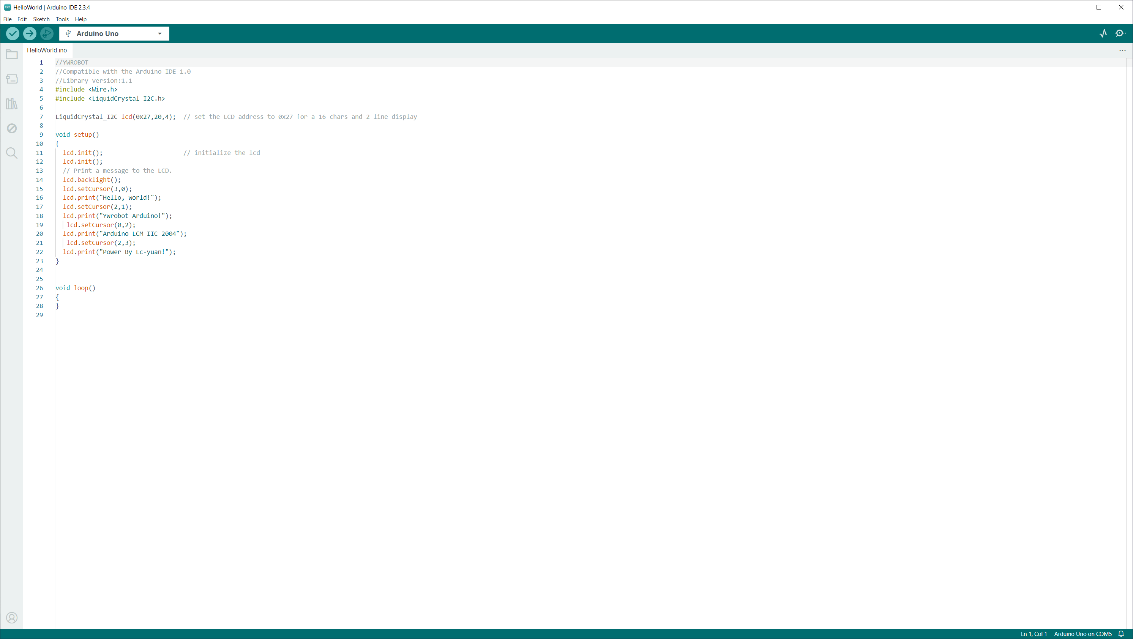
Now to use the the I2C LCD.
Select menu File→ Example →
LiquidCrystal I2C →
Hello World
Do not worry if the characters are odd. This example is for 20x4 LCD. Just be sure there are characters displayed.

Slide 15
//Compatible with the Arduino IDE 1.0
//Library version:1.1
#include <Wire.h>
#include <LiquidCrystal_I2C.h>
LiquidCrystal_I2C lcd(0x27,16,2); // set the LCD address to 0x27 for a 16 chars and 2 line display
void setup()
{
lcd.init(); // initialize the lcd
lcd.init();
// Print a message to the LCD.
lcd.backlight();
lcd.setCursor(3,0);
lcd.print("Hello, world!");
lcd.setCursor(2,1);
lcd.print("Ywrobot Arduino!");
Delay(2000);
lcd.setCursor(0,0);
lcd.print("Arduino LCM IIC 2004");
lcd.setCursor(0,1);
lcd.print("Power By Ec-yuan!");
delay(2000);}
void loop()
{}
Use this sketch and you should get text on the LCD. (the exmaple is for 20 char 4 lines, so it DOES work, but will look odd.
The point is to get text on the LCD.
Now for the payoff.
We will borrow lines here to add the the AHT10 sketch to write the temperature and humidity to the LCD.

Slide 16
#include <Wire.h>
#include <LiquidCrystal_I2C.h>
LiquidCrystal_I2C lcd(0x27,16,2); // set the LCD address to 0x27 for a 16 chars and 2 line display
lcd.init(); // initialize the lcd
lcd.init();
// Print a message to the LCD.
lcd.backlight();
lcd.setCursor(3,0);
lcd.print("Hello, world!");
lcd.setCursor(2,1);
lcd.print("Ywrobot Arduino!");
These are the important lines to be added and tweaked.

Slide 17
#include <Adafruit_AHT10.h>
#include <Wire.h>
#include <LiquidCrystal_I2C.h>
Adafruit_AHT10 aht;
LiquidCrystal_I2C lcd(0x27,16,2); // set the LCD address to 0x27for a 16 char/2 line display
void setup()
{
Serial.begin(115200);
Serial.println("Adafruit AHT10 demo!");
if (! aht.begin())
{
Serial.println("Could not find AHT10? Check wiring");
while (1) delay(10);
}
Serial.println("AHT10 found");
lcd.init(); // initialize the lcd lcd.init();
// Print a message to the LCD.
lcd.backlight();
}
void loop()
{
sensors_event_t humidity, temp;
aht.getEvent(&humidity, &temp);
// populate temp and humidity objects with fresh data Serial.print("Temperature: "); Serial.print(temp.temperature); Serial.println(" degrees C"); lcd.setCursor(0,0); lcd.print("Temp "); lcd.print(temp.temperature); lcd.println(" deg C "); lcd.setCursor(0,1);
Serial.print("Humidity: "); Serial.print(humidity.relative_humidity); Serial.println("% rH"); lcd.print("Hum "); lcd.print(humidity.relative_humidity); lcd.println("% rH ");
Delay(2500);
}
This is the final result. Let’s look in detail at the lcd.print messages.

Slide 18
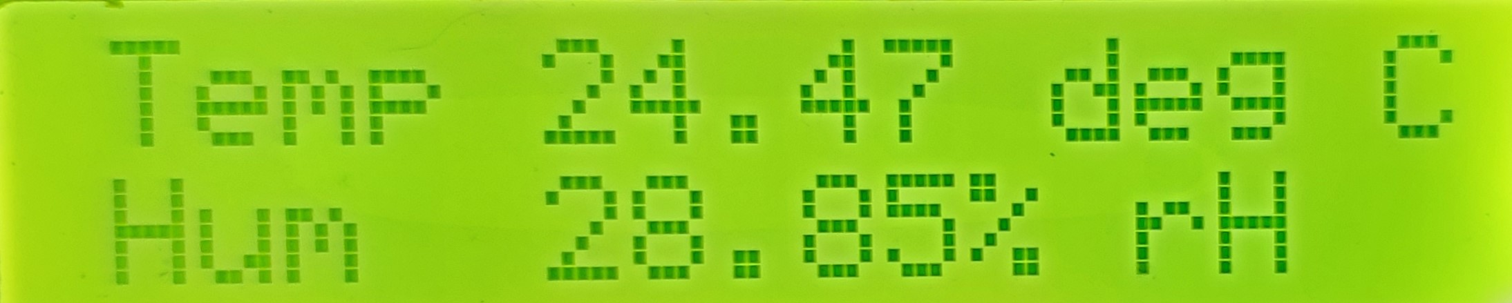
Here is the LCD output from the above sketch

Slide 19
The End

